Slide 1
TECH-NOLOGY: Tools for Success
Chapter 4

Slide 2
CHAPTER OBJECTIVES
Identify useful technology tools at Louisiana Tech and other reliable sources.
Utilize technology for email, course management, student information, and academic activity.
Demonstrate an understanding of appropriate use of technology.
Employ media literacy in the use of technology for personal and academic pursuits.

Slide 3
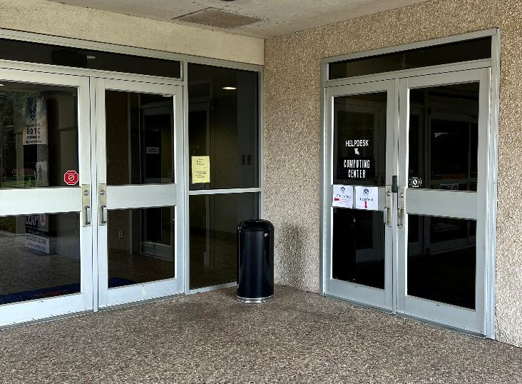
THE IT HELP DESK
The Helpdesk can provide information and technical assistance for:
User Accounts
Campus Wi-Fi
Email
Computer Labs
Online Technology Resources
The Computing Center & Help Desk is located in the basement of Wyly Tower with student access through the exterior door (pictured above) located on quad-side entrance to Wyly Tower.
Contact the Helpdesk at 318.257.5300 or by email at helpdesk@latech.edu

Slide 4
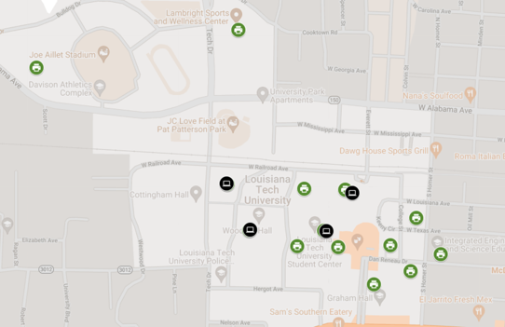
COMPUTER LABS & PRINT STATIONS
PRINT STATIONS
George T. Madison (1st Floor SW Entrance)
Prescott Memorial Library (Main & 10th Floor)
College of Business Building (Room 104 & 106)
Integrated Eng. & Science Building (1st Floor)
Nethken Hall (1st Floor – Room 142)
Bogard Hall (3rd Floor – Room 322)
Carson-Taylor Hall (1st Floor)
Howard Auditorium (3rd Floor – Music Wing)
Tolliver Hall (Near Centennial Plaza Exit)
Woodard Hall (Student Lounge – Room 130A)
Memorial Gym (2nd Floor – Room 219)
COMPUTER LABS
Student Center/TONK
Prescott Memorial Library (Main Floor)
Memorial Gym
Woodard Hall

Slide 5
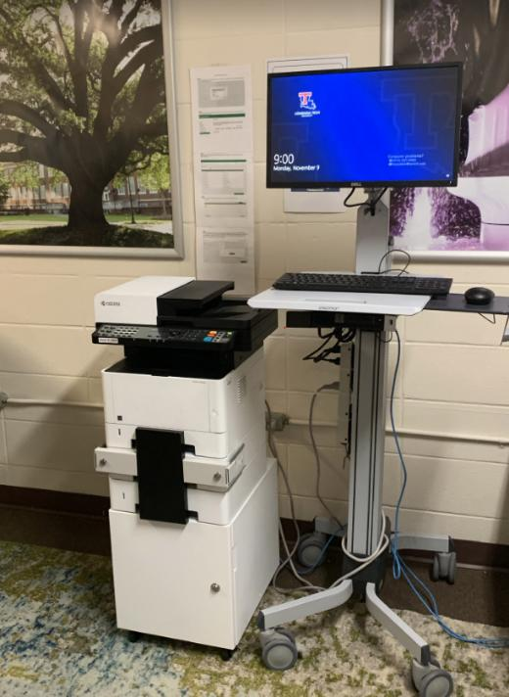
REMOTE PRINTER STATIONS
To print using one of the remote printer labs:
Navigate to print.latech.edu
Log-in using Tech username
Select “Web Print” > “Submit a Job”
Select a Print Location
Upload Your Document

Slide 6
CAMPUS EMAIL
All students have access to their campus email (abc123@latech.edu) through gmail.latech.edu. Email is the primary means of communication with your professors and university departments. Be sure to follow appropriate email etiquette (p. 34) when communicating with an instructor.
Use your university email
Address your professor directly
Make sure your first sentence identifies who you are by name
Be sure to include a meaningful subject line
Be polite
Be succinct
Be specific
If you’re going to have to miss class...
Close your email politely
Grammar and spell check

Slide 7
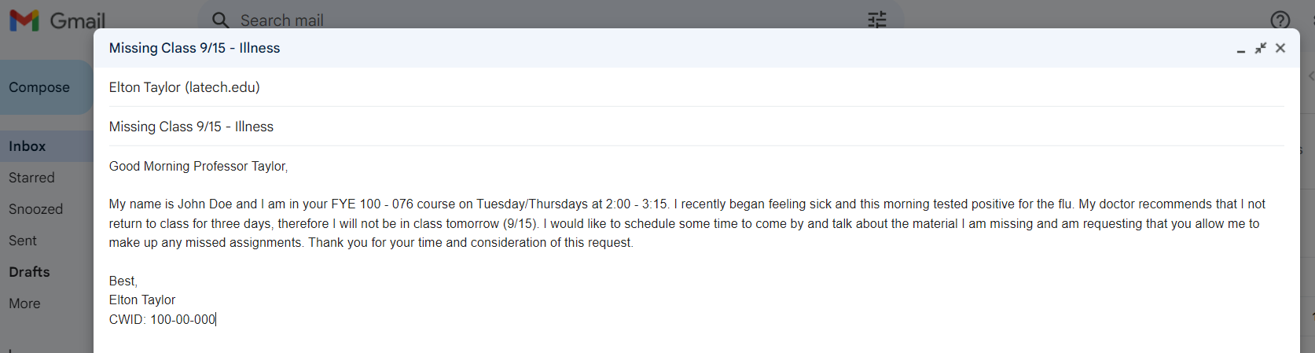
EMAIL ETIQUETTE
Following the Email Etiquette 101 tips found on page 34, complete activity 4.1 (example above).

Slide 8
IMPORTANT WEBSITES
OFFICE 365
STAR REZ HOUSING PORTAL
CANVAS
NET PARTNER
HANDSHAKE
ACADEMIC WORKS
Cloud-based Microsoft Office Suite applications available online and accessible from any device.
The on-campus Housing Application and Meal Plan Selection web portal
The Learning Management System for all Louisiana Tech classes.
Official Financial Aid portal for Louisiana Tech students. Manage your documents, accept your aid, and more.
The Career Center’s management system for job posting board and employer partner information.
Louisiana Tech’s Online Scholarship System.

Slide 9
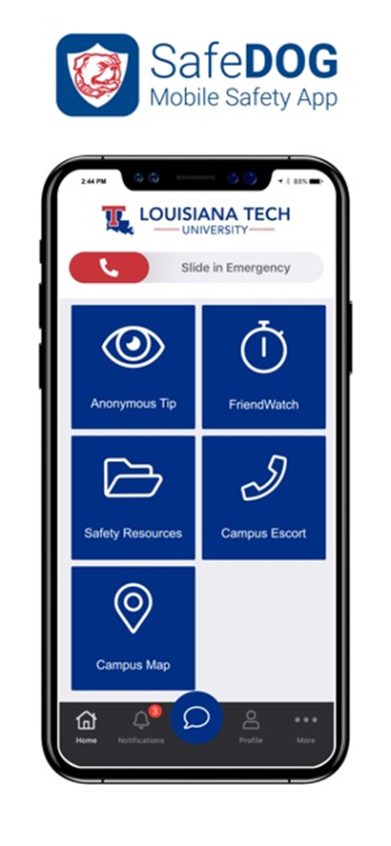
TECHNOLOGY AND SAFETY
SafeDog App
Emergency Notification System (sign-up through Workday Student)
Be careful what you post on Social Media
Recognizing and Avoiding Scams

Slide 10



A phishing message is designed to trick you
into doing one of these four things.
Click Here!
USERNAME
************
Click an
Unsafe Link
Open an
Unsafe File
Type your
Password
Transfer
Funds
Click an
Unsafe Link
Open an
Unsafe File

Slide 11






Phishing messages are designed to get you to react quickly without thinking too much.
Sense of Urgency
Offers of Money
Confirmations
Odd Requests
Rewards
IT Support

Slide 12



What happens when I get a phishing email?
Click
Delete
Report

Slide 13

WHAT HAPPENS IF I CLICK?
Password Stolen
Identity Theft
Data Leak
Data Destruction
Account Takeover
Malware Installed
Stolen Password
Remote Access
Ransomeware
Network Compromise
So be vigilant, be careful, and if you do accidentally click a link, contact the HelpDesk immediately.

Slide 14






TECHNOLOGY TIPS
Utilize the Canvas and Workday Apps
Laptop Rentals in Prescott Memorial Library
Setup your Tech Email on your phone
Free Microsoft for Students
Free, On-Campus Streaming Service – Dogflix.latech.edu
Student Discounts on Technology

